Slide 1
Interactive UIs: State & Binding

Slide 2
Controls
TextField
Button
Action
Property
Property Wrapper
State
Binding

Slide 3
Use actions to update the UI based on user input
Configure UI elements to trigger actions in views
Manage view state using SwiftUI’s @State property wrapper

Slide 4

Warm-Up
Team up with a partner who has an iOS device. Decide who will be Partner A (Driver - needs an iOS device) and Partner B (Recorder - needs ✏️ and 📄).
Partner A: Add a new event of your choice to your calendar. Make sure to explore all the various ways you can “customize” the event.
Partner B: Note down each time the Calendar App takes user input from Partner A. Make sure to note what the user input is (text, click, etc…).

Slide 5
Reflection
Partner A - What were some of the ways you were able to “customize” the event?
Partner B - When did the Calendar App take user input from Partner A? What kind of input did it take (strings, booleans, etc.)?

Slide 6

Interactive Apps
Up until now, we've built the visual framework (UI) of our apps.
Now it’s time to bring them to life by adding interactivity—just like the dynamic Calendar app in your warm-up.
When you tap the plus sign, type an event title, or scroll through dates and times, the app reacts to your every action. This is the power of an interactive user interface in action.

Slide 7
Controls
Controls enable user interaction and include elements such as buttons, text fields, and toggles.
We can still apply modifiers to customize the design of controls.
Views and controls are the visual building blocks of your app’s user interface.

Slide 8
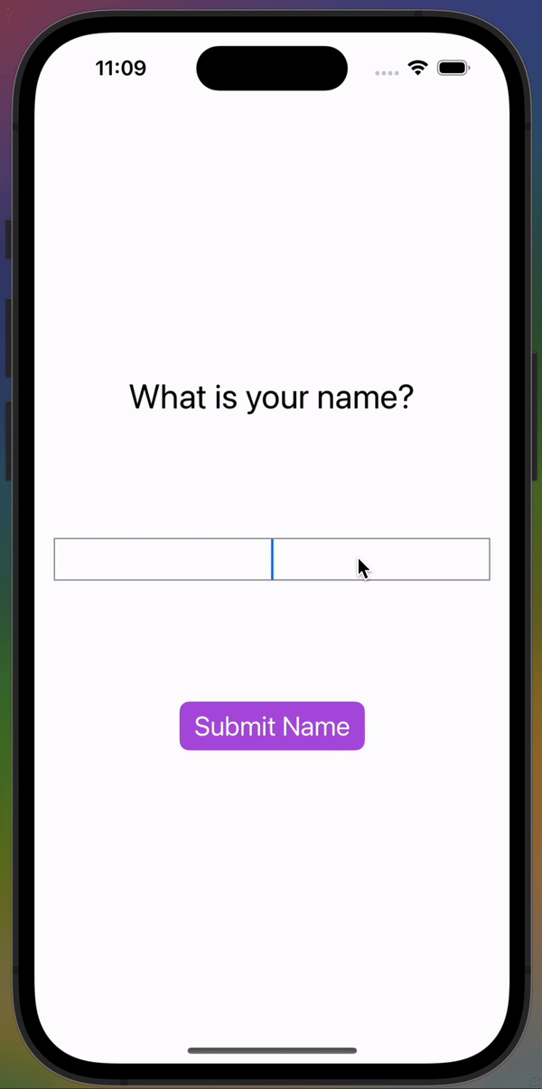
Goal
We are going to create our first interactive app with a combination of views and controls.
Goal: When the user types something in the text field and clicks the button, the text they typed becomes the text at the top of the app!

Slide 9
UI Planning
What views and stacks do you need for this app?

Slide 10
Create a New Project
For this project, we need 3 views:
Text
Text input field
Button
And all of these elements are nested within a VStack! Create a new Xcode project called InteractiveUI.

Slide 11


Git & GitHub Setup
Step 1: Initialize a local Git repository with Integrate > New Git Repository > Create.
Step 2: Select Source Control Navigation in the Navigation Pane and then Repositories.
Step 3: Control-click Remotes and select New <ProjectName> Remote…
Step 4: Click Create and check out your repo on GitHub!
‹#›

Slide 12
Getting Started
Delete the starter code within the body and add a VStack and a Text subview.
Change the text to the string "What is your name?" and customize the font to be title size.

Slide 13
Git & GitHub Checkpoint
Step 1: Add your changes to the staging area with Integrate > Stage All Changes.
Step 2: Save your work with Integrate > Commit and write a detailed commit message before clicking the Commit button.
Step 3: Push your changes to GitHub with Integrate > Push. Click Push when the new window opens and check out your work on GitHub!
‹#›

Slide 14
Setting up the UI: TextField
Add a TextField from the library below the text view
Read about the TextField control in the docs

Slide 15
Setting up the UI: TextField
Add a TextField from the library below the text view
Read about the TextField control in the docs
Change the “Placeholder” text to “Type your name here…”

Slide 16
Setting up the UI: TextField
Add a TextField from the library below the text view
Read about the TextField control in the docs
Change the “Placeholder” text to “Type your name here…”
Add modifiers to the TextField:
.multilineTextAlignment(.center)
.font(.title)
.border(Color.gray, width: 1)
Add the .padding() modifier to the VStack

Slide 17


Setting up the UI: Button
Add a Button from the library under the text field in the Vstack
Read about the Button control in the docs
‹#›

Slide 18
Setting up the UI: Button
Add a Button from the library under the text field in the Vstack
Read about the Button control in the docs
Replace the “Button” string with “Submit Name”
Button("Submit Name") {
}
.font(.title2)
.buttonStyle(.borderedProminent)
.tint(.purple)
‹#›

Slide 19
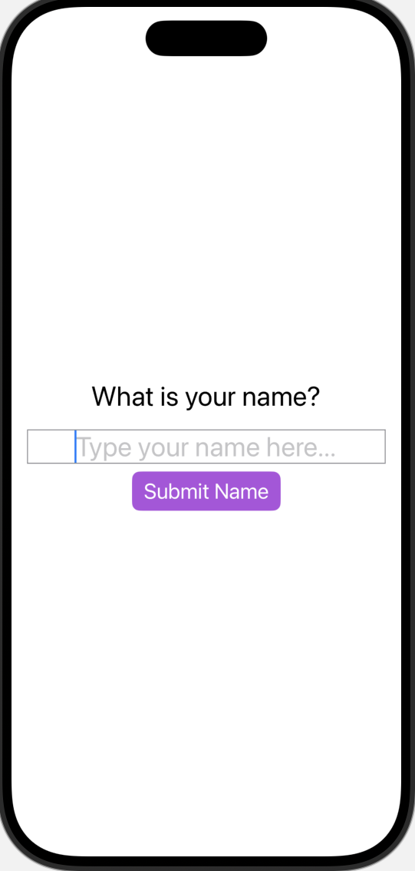

Slide 20
Git & GitHub Checkpoint
Step 1: Add your changes to the staging area with Integrate > Stage All Changes.
Step 2: Save your work with Integrate > Commit and write a detailed commit message before clicking the Commit button.
Step 3: Push your changes to GitHub with Integrate > Push. Click Push when the new window opens and check out your work on GitHub!
‹#›

Slide 21
Brainstorm
What do we expect to happen when the user clicks the button?
What information do we need to keep track of?

Slide 22
Brainstorm
Goal: Update the text to reflect what the user types when they click submit!
To accomplish this, we need a way to keep track of what the user types in the TextField!
How will we keep track of this data the user types in?

Slide 23
Properties & Wrappers
We need to store the text the user types into the TextField in a variable.
This variable is called a property of the struct.
We’ll call this property name and assign it to an empty string.
Property wrappers are like cool accessories you attach to your variable to give it additional behavior.
struct ContentView: View {
var name = ""

Slide 24



State
@State is a property wrapper!
This property wrapper monitors changes and tells SwiftUI to update the view whenever that variable is modified.
struct ContentView: View {
@State private var name = ""

Slide 25
Binding
To make the value the user types in the TextField update the current value of the name property and display it as the user types, we use two-way binding with the $.
TextField("Type your name here...", text: $name)
.multilineTextAlignment(.center)
.font(.title)
.border(Color.gray, width: 1)

Slide 26
Add an Action to the Button
Replace the Button Action with print(name)
Button("Submit Name") {
print(name)
}

Slide 27

Add an Action to the Button
Replace the Button Action with print(name)
Button("Submit Name") {
print(name)
}
Type something in the text field and then click the button a few times. What happens?

Slide 28
Add an Action to the Button
Replace the Button Action with print(name)
Create another property called textTitle at the top of your app and assign it to the string “What is your name?”
@State private var textTitle = "What is your name?"

Slide 29
Add an Action to the Button
Replace the Button Action with print(name)
Create another property called textTitle at the top of your app and assign it to the string “What is your name?”
Replace the static string in the Text view with the textTitle variable
Text(textTitle)

Slide 30
Add an Action to the Button
Replace the Button Action with print(name)
Create another property called textTitle at the top of your app and assign it to the string “What is your name?”
Replace the static string in the Text view with the textTitle variable
Update the Action for the Button: when the button is tapped, the textTitle is updated to the string “Welcome, <name>!” based on the user’s input

Slide 31
Button("Submit Name") {
textTitle = "Welcome, \(name)!"
}

Slide 32
🎉 Congratulations, you built your first interactive UI!

Slide 33
Git & GitHub Checkpoint
Step 1: Add your changes to the staging area with Integrate > Stage All Changes.
Step 2: Save your work with Integrate > Commit and write a detailed commit message before clicking the Commit button.
Step 3: Push your changes to GitHub with Integrate > Push. Click Push when the new window opens and check out your work on GitHub!
‹#›

Slide 34
How do you know when you should use a property to store a piece of data?

Slide 35
Practice
Reference the practice in the lesson for details!

Slide 36
Git & GitHub Checkpoint
Step 1: Add your changes to the staging area with Integrate > Stage All Changes.
Step 2: Save your work with Integrate > Commit and write a detailed commit message before clicking the Commit button.
Step 3: Push your changes to GitHub with Integrate > Push. Click Push when the new window opens and check out your work on GitHub!
‹#›

Slide 37


Show & Tell Time!
5
mins
mins
mins
Independently prepare for Show & Tell
Share in groups of 2-3
Introduce yourself
Go over the app you created
Name what you are most proud of!
Others should share GLOWS!!!
Switch

